Slide 1

CAR NUMBER PLATE RECOGNITION
BITI 3313 IMAGE PROCESSING AND PATTERN RECOGNITION
GROUP PROJECT
GROUP MEMBERS:
NAME | MATRIC NO
AHNUSIYAA A/P SEKARAN | B032210015
RASHMIKA A/P KATHIRAVAN | B0321110121
MUHAMMAD SHAHRIZAD BIN MOHD SHAMSUDI | B032110172

Slide 2
Video presentation link:
https://youtu.be/4uL0TnLiM9w

Slide 3
01
Problem Background

Slide 4
Problem Background
Car number plate detection involves automating the process of locating and extracting number plates from the car images. This is common problem in the field of computer vision and has various application such as automated toll collection and parking management.
Number plate detection relied on manual inspection by human
operators. With advancement in image processing techniques and computer vision algorithms, it has become possible to develop automated systems that can accurately locate and extract number plate from car images.
The objective of the project are:
Develop an automated system that can accurately locate and extract the number plate from car images.
To provide an automated solution for accurately and efficiently detecting car number plates.

Slide 5
02
Methodology

Slide 6
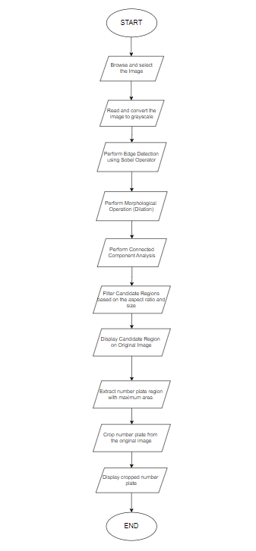
Methodology
Browse and select image: The user is prompted to browse and select an image file.
Read and convert: The selected image file is read using the ‘imread’ function and converted to grayscale using the ‘rgb2gray’ function.
Edge Detection: The sobel operator is applied to the grayscale image to detect using the ‘edge’ function.
Morphological Operations: The detected edges are enhanced using morphological dilation. A rectangular structuring element is created using the ‘strel’ function and the ‘imdilate’ function is used to perform dilation on the edge image.
Connected Component Analysis: Connected component analysis is performed on the dilated image using the ‘bwconncom’ function. This step identifies distinct regions or connected component in the image.

Slide 7
Methodology
6. Filter Candidate Regions: The candidate regions obtained from the connected component analysis are filtered based on their aspect ratio and size. Regions with aspect ratios between 2 and 5 are considered valid.. Filtering is performed using logical indexing.
7. Display Candidate Regions: The valid candidate regions, representing potential number plates, are displayed on the original image. Green rectangles are dawn around the ‘rectangle’ function.
8. Extract Number Plate Region: The region with the maximum area among the valid candidate regions is selected as the number plate region. The maximum area is determined using the ‘max’ function.
9. Crop Number Plate: The number plate region is cropped from the original image using the ‘imcrop’ function.
10. Display Cropped Number Plate: The cropped number plate is displayed in a separate figure.

Slide 8
03
Program Codes

Slide 9
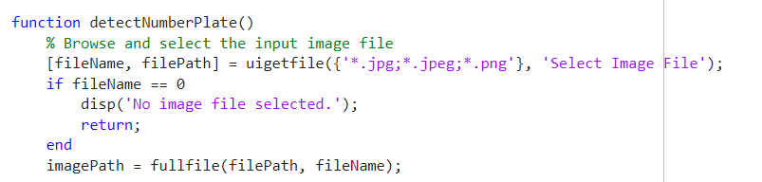
Program Codes (function)

Slide 10
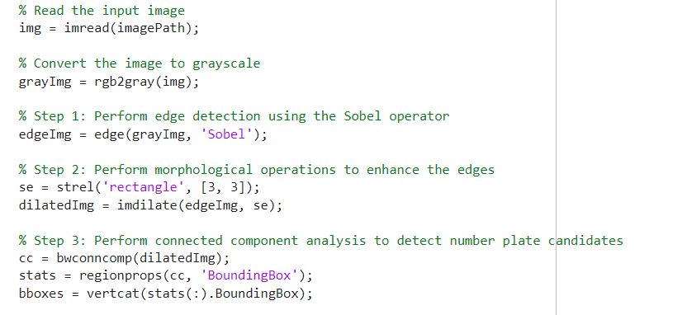
Program Codes (script)

Slide 11
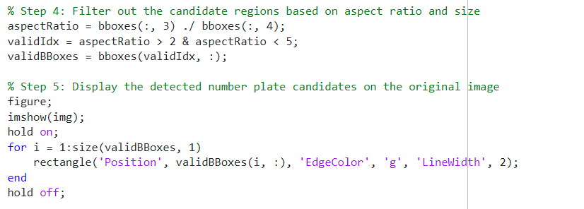
Program Codes (script)

Slide 12
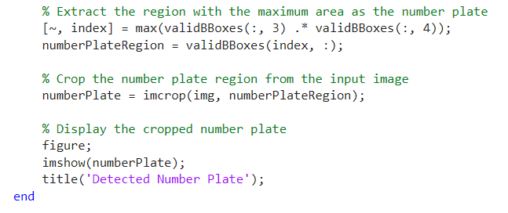
Program Codes (script)

Slide 13
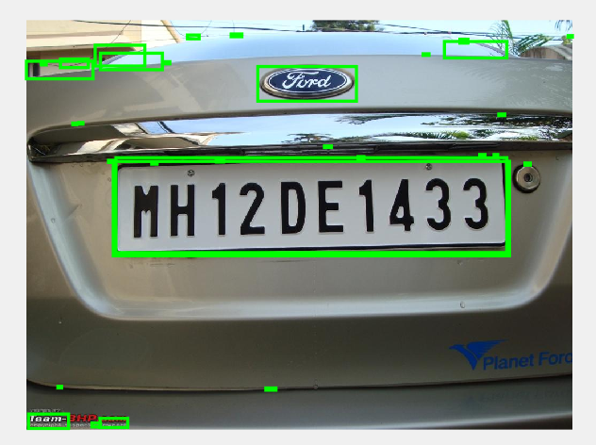
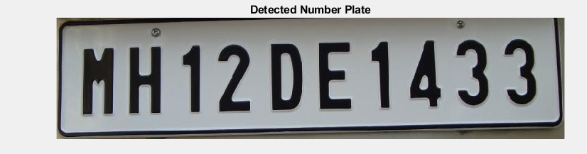
Output 1
The output displays the original image with green rectangles highlighting the potential number plate regions. Additionally, a separate figure shows the cropped and extracted number plate region. This output allows you to visually inspect the detected number plate and access the accuracy of the detection algorithm.

Slide 14
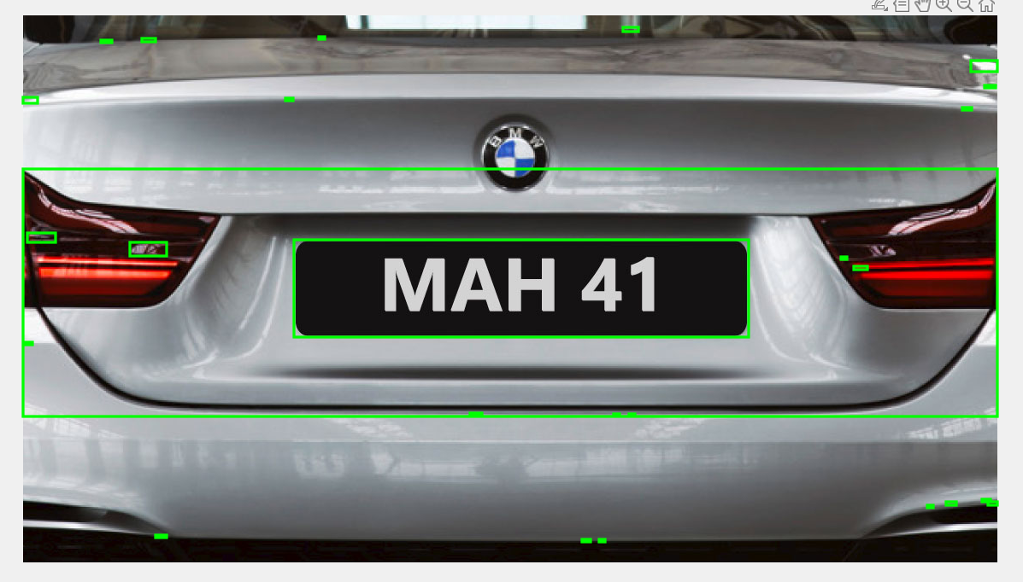
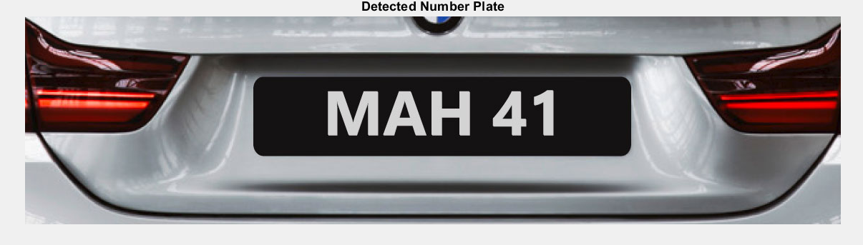
Output 2

Slide 15
Conclusion
The number plate detection algorithm presented in this report offers an automated and efficient approach to identify and extract number plates from images. By utilizing image processing techniques, it accurately locates number plates in various environments. The algorithm's strengths lie in its edge detection, morphological operations, and connected component analysis, enabling the filtering and visualization of number plate candidates.
However, challenges such as image quality and variations in number plate designs should be addressed for improved performance. Future developments, including the integration of machine learning, hold promise for enhancing accuracy and robustness.Overall, the algorithm provides a foundation for streamlining applications that require precise vehicle identification and tracking.

Slide 16
List of references
‘Automatic vehicle number plate detection and recognition using image processing’ (2017) International Journal of Advance Engineering and Research Development, 4(10). doi:10.21090/ijaerd.74192.
Anish, T.P. and Prathap, P.M.J. (1970) Automated Vehicle Number Recognition Scheme using neural networks, SpringerLink. Available at: https://link.springer.com/chapter/10.1007/978-3-031-12638-3_23
Rahman, Md.A. (2017) Automatic Vehicle Number Plate Detection &amp; Recognition, Academia.edu. Available at: https://www.academia.edu/33603141/Automatic_Vehicle_Number_Plate_Detection_and_Recognition

Slide 17

Thank youuu!!

